Slide 1


Module 3
Back-End Development & Integration
Notes:
In the Trainer would briefly explain the module name, the importance of having the Back-End Development and how we can integrate it with Front End Frameworks

Slide 2
Unit - 3
Data Persistence and Database Integration
Notes:
In this slide the Trainer would introduce the Unit 3 of the module to the students – What is Data Persistence ? - How do we integrate database in Full Stack Web Development?
What is the role of Database in Full Stack Development? Once the trainer queried from the students. Trainer may explain the meaning of Persistence and Integration to the students.
---------------------------------------------------------------
Data persistence, the ability to retain data beyond a system's runtime, is a crucial aspect of software development. It ensures that valuable information remains available even after an application or system is closed or restarted. This continuity is essential for maintaining user experiences and enabling applications to resume operations seamlessly. To achieve effective data persistence, integrating with databases is a common practice. Database integration involves connecting an application with a structured data storage system, such as SQL or NoSQL databases. This integration offers several benefits, including organized data management, efficient data retrieval, and the ability to perform complex queries and analysis. Depending on the nature of the data and its requirements, different types of databases can be chosen. SQL databases provide a structured format suitable for well-defined data, while NoSQL databases offer flexibility for handling unstructured or semi-structured data. Regardless of the chosen database type, successful integration requires careful consideration of factors like data modeling, security implementation, and backup strategies to ensure reliable and secure management of persistent data.

Slide 3
Disclaimer
The content is curated from online/offline resources and is used for educational purpose only
Notes:
Trainer would be briefing the students that this content has been prepared for the educational purpose only and is referred from multiple sites which are cited in the last.
---------------------------------------------------
A disclaimer is a statement or notice that is intended to clarify, limit, or provide information about the scope, limitations, or potential risks associated with certain actions, information, products, services, or content.

Slide 4

Learning Objectives
You will learn in this lesson:
Gain a solid understanding of fundamental database concepts.
Understand the role and importance of RDBMS in managing structured data efficiently.
Master SQL for querying and manipulating data in a relational database, including SELECT, INSERT, UPDATE, and DELETE operations.
Get familiar with MySQL RDBMS, its features, installation, and configuration.
Learn about the various concepts related to MySQL.
Notes:
In this slide, Trainer would be making understand the students – What are the benefits of the topics, What will be objective. How the topic will be benefitted in order to develop the skill.
---------------------------------------------------
These are the expected knowledge, skills, and abilities that learners should acquire after completing a learning experience, such as a course, training program, workshop, or educational module.

Slide 5
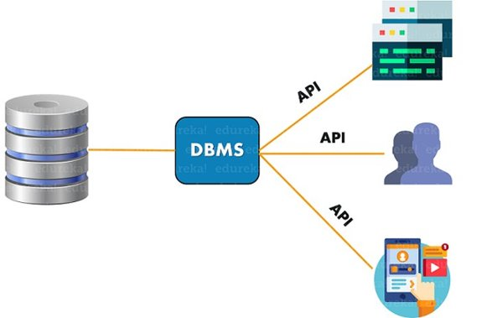
Use Case of DBMS
A Database Management System (DBMS) is a software tool used to manage and organize data efficiently. DBMS serves as an intermediary between users and databases, providing an interface for users to interact with the data stored in the database​
​
Click here
Reference link
Notes:
Before starting the original content, Trainer may ask the students some of the use case of the related topic, so that it creates a zeal among the students for the topic. May be students have used the technique before but they are not aware of the application areas. This slide will make them deep dive into the topic.
------------------------------------------------------------------------------------
A Database Management System (DBMS) is a software tool used to manage and organize data efficiently. DBMS serves as an intermediary between users and databases, providing an interface for users to interact with the data stored in the database

Slide 6

Introduction
A Database Management System (DBMS) is a software system that allows users to interact with a database. It serves as an intermediary between applications and the underlying database, facilitating the creation, retrieval, updating, and management of data in a structured and organized manner. MySQL is a popular open-source relational database management system (RDBMS) that is widely used for building web applications.
Notes:
Trainer will brief the students about the concepts of database. He/she may ask the students about some basics of DBMS. How they have used DBMS till now in their Graduation course.
--------------------------------------------------------
A Database Management System (DBMS) functions as a pivotal software system that enables users to seamlessly interact with databases. Acting as an intermediary between applications and the underlying database, it streamlines the intricate processes of data creation, retrieval, updates, and overall management. By enforcing structured and organized data storage, the DBMS enhances the efficiency and accessibility of information. An example of such a system is MySQL, a widely acclaimed open-source Relational Database Management System (RDBMS). Its popularity predominantly shines in the realm of web application development, where its robustness and compatibility make it a preferred choice for efficiently managing data in dynamic online environments.

Slide 7
What is a DBMS?
Definition
Uses
Security
A DBMS is a software system that allows users to define, create, maintain, and control access to a database.
DBMS is used in many fields, including business, education, healthcare, and government, to manage and organize large amounts of data.
DBMS provides security features such as access control, backup and recovery, and data encryption to protect sensitive information.
Notes:
In this slide – Trainer will brief the students about the benefits of learning Database Management System, Its uses and its security concerns.
-----------------------------
- **DBMS Definition:** A Database Management System (DBMS) is a software that facilitates efficient data storage, retrieval, and manipulation. It acts as an intermediary between user applications and databases, ensuring organized and structured data management.
- **Uses of DBMS:** DBMS plays a pivotal role in various applications, from business operations to scientific research. It enables streamlined data handling, accelerates decision-making through efficient querying, and supports scalability as data volumes grow.
- **Security Focus:** DBMS offers crucial security features like access control, authentication, and encryption to safeguard sensitive data from unauthorized access and potential breaches. It ensures data integrity, confidentiality, and availability.
- **Balancing Act:** While providing efficient data management and security, DBMS must strike a balance to avoid overly complex systems that hinder performance or create vulnerabilities. Proper design and management are essential for optimal outcomes.

Slide 8
Advantages of DBMS
Efficiency
Scalability
DBMS allows users to access data quickly and efficiently, reducing the time and effort required to manage and process large amounts of information.
DBMS can handle large amounts of data and can be easily modified to adapt to changing business needs, making it scalable and flexible.
Data Integrity
Multitasking
With DBMS, data is centralized and consistent, reducing the risk of data being duplicated or lost and ensuring data integrity.
DBMS allows multiple users to access the same data simultaneously, enabling collaborative efforts that can be carried out effectively and efficiently.
Notes:
Trainer discuss the advantages of using DBMS
- **Efficiency:** A key advantage of a Database Management System (DBMS) lies in its efficient data handling. Through optimized storage structures and indexing techniques, data retrieval becomes faster, contributing to improved application performance and user satisfaction.
- **Scalability:** DBMS systems are designed to accommodate growing data volumes seamlessly. As data demands increase, the DBMS can be scaled up by adding hardware resources or optimized for larger datasets without compromising efficiency.
- **Data Integrity:** DBMS ensures data accuracy and consistency by enforcing validation rules and relational constraints. This prevents data anomalies and errors, maintaining the reliability of the information stored.
- **Multitasking:** DBMS enables concurrent access by multiple users or applications, allowing tasks to be executed simultaneously without data conflicts. This enhances productivity and responsiveness, making it suitable for complex and dynamic environments.

Slide 9
Disadvantages of Using DBMS
Complexity
DBMS can be complex, and may require specialized knowledge to operate and maintain. It may also require additional investments in staff training and education.
1
2
3
Cost
Vendor Dependency
DBMS can be quite expensive, as licensing costs and hardware requirements can add up quickly, especially for large organizations.
DBMS can be provided by a limited number of vendors, which can create a dependency on the vendor and limit the ability to customize the DBMS to specific requirements.
Notes:
Trainer discuss the disadvantages of using DBMS
- **Cost Implications:** One notable disadvantage of a Database Management System (DBMS) is the associated costs. Setting up and maintaining a robust DBMS requires investment in software licenses, hardware infrastructure, and skilled personnel, which can strain budgets.
- **Complexity:** DBMS systems, while offering numerous benefits, can also introduce complexity. Designing, implementing, and managing a DBMS demands expertise and careful planning, which can lead to increased complexity, especially for smaller projects.
- **Vendor Dependency:** Adopting a DBMS often means relying on a specific vendor's technology. This dependency can limit flexibility and tie an organization to a particular vendor's pricing, support, and updates, potentially reducing future options.
-

Slide 10

MySQL Database
MySQL is one of the most popular database management systems (DBMSs) on the market today.
It ranked second only to the Oracle DBMS in this year’s DB-Engines Ranking.
As most software applications need to interact with data in some form, programming languages like Python provide tools for storing and accessing these data sources.
Notes:
In this slide – Trainer will brief the students about the MySQL Database
-----------------------------
MySQL is a relational database management system renowned for its foundation on the Structured Query Language (SQL), a widely adopted language for interacting with and managing database records. Notably, MySQL is open-source and falls under the GNU license, making it an accessible and cost-effective option for various users. Backed by the Oracle Company, MySQL benefits from credible support and ongoing development efforts. Its widespread popularity is evident, as it holds a prominent position in the DB-Engines Ranking, second only to the Oracle DBMS. This market recognition reflects MySQL's capability to cater to diverse data management needs efficiently and reliably.

Slide 11
MySQL Database
Being open source since its inception in 1995, MySQL quickly became a market leader among SQL solutions.
MySQL is also a part of the Oracle ecosystem.
While its core functionality is completely free, there are some paid add-ons as well.
Currently, MySQL is used by all major tech firms, including Google, LinkedIn, Uber, Netflix, Twitter, and others.
Notes:
In this slide – Trainer will explain the students about MySQL and the companys using MySQL
-----------------------------
Since its inception in 1995 as an open-source solution, MySQL swiftly emerged as a dominant force in the realm of SQL-based databases. Its open-source nature not only fostered innovation but also established its market leadership. Notably, MySQL has become a vital component within the Oracle ecosystem, aligning itself with a reputable entity that bolsters its development and support resources. While the core functionalities of MySQL remain freely accessible, the availability of paid add-ons introduces a mixed licensing model that caters to diverse user needs. Its influence is evidenced by its adoption among industry giants such as Google, LinkedIn, Uber, Netflix, and Twitter, underlining MySQL's significance in powering critical data-driven applications.

Slide 12
Installing MySQL Connector/Python
MySQL Database
A database driver is a piece of software that allows an application to connect and interact with a database system. Programming languages like Python need a special driver before they can speak to a database from a specific vendor.
In Python you need to install a Python MySQL connector to interact with a MySQL database. Many packages follow the DB-API standards, but the most popular among them is MySQL Connector/Python. You can get it with pip:
pip install mysql-connector-python
Notes:
In this slide – Trainer will brief the students about how to install MySQL and show a live demo of installing
-----------------------------
A database driver serves as a vital intermediary, enabling applications to establish connections and interact with database systems seamlessly. Particularly in languages like Python, a dedicated driver is essential to facilitate communication with databases from specific vendors. In the context of Python's interaction with MySQL databases, the integration hinges on installing a suitable driver. While numerous packages adhere to the DB-API standards, MySQL Connector/Python emerges as the favored choice due to its popularity and compatibility. To incorporate this connector, the process is simplified through the "pip install mysql-connector-python" command, which efficiently fetches and configures the necessary components, ensuring smooth and effective communication between Python and MySQL databases.

Slide 13
Installing MySQL Connector/Python
MySQL Database
To test if the installation was successful, type the following command on your Python terminal:
import mysql.connector
If the above code executes with no errors, then mysql.connector is installed and ready to use. If you encounter any errors, then make sure you’re in the correct virtual environment and you’re using the right Python interpreter.
Make sure that you’re installing the correct mysql-connector-python package, which is a pure-Python implementation. Beware of similarly named but now depreciated connectors like mysql-connector.
Notes:
In this slide – Trainer will show the way to find whether the installing was successful or not.
-----------------------------
To verify the successful installation, you can employ a straightforward test within your Python terminal. Simply type in "import mysql.connector," and if this code executes without any errors, you'll have confirmation that mysql.connector is indeed installed and primed for utilization. In case you come across any errors, it's advisable to double-check that you're operating within the correct virtual environment and employing the appropriate Python interpreter.
Additionally, a word of caution is warranted regarding the installation process. It's crucial to ensure that you're selecting the precise mysql-connector-python package, which constitutes a pure-Python implementation. It's easy to mistake it for similar but now deprecated connectors like mysql-connector. Staying vigilant about these details will aid in the seamless setup and effective utilization of the MySQL Connector/Python package.

Slide 14
Establishing a Connection With MySQL Server
MySQL Database
MySQL is a server-based database management system. One server might contain multiple databases. To interact with a database, you must first establish a connection with the server. The general workflow of a Python program that interacts with a MySQL-based database is as follows:
Connect to the MySQL server.
Create a new database.
Connect to the newly created or an existing database.
Execute a SQL query and fetch results.
Inform the database if any changes are made to a table.
Close the connection to the MySQL server.
This is a generic workflow that might vary depending on the individual application. But whatever the application might be, the first step is to connect your database with your application.
Notes:
In this slide – Trainer will show to the students how to connect with MySQL sever in step by step.
-----------------------------
MySQL functions as a server-based database management system with the capacity to host multiple databases on a single server. The initial interaction with a database involves establishing a connection to the server, setting the groundwork for subsequent actions. In the context of Python programs engaging with MySQL-based databases, a well-defined workflow unfolds. This entails connecting to the MySQL server, potentially creating a new database, and subsequently linking to either newly established or existing databases. Central to this process is the execution of SQL queries, enabling data retrieval, manipulation, and updates, with results fetched accordingly. Guaranteeing the accuracy of database reflections upon table alterations is paramount. Efficiently concluding the operation necessitates the closure of the connection to the MySQL server. Although variations might arise based on individual application requirements, the pivotal initiation step, connecting the application with the database, remains constant.

Slide 15
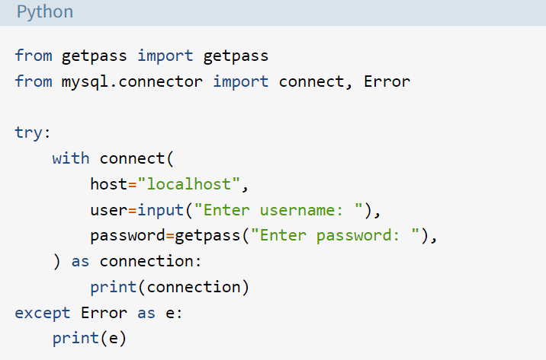
Establishing a Connection With MySQL Server
MySQL Database
The first step in interacting with a MySQL server is to establish a connection.
To do this, you need connect() from the mysql.connector module.
This function takes in parameters like host, user, and password and returns a MySQLConnection object.
You can receive these credentials as input from the user and pass them to connect():
Notes:
In this slide – Trainer will show to the students how to connect with MySQL sever in step by step.
-----------------------------
The initial phase of engaging with a MySQL server involves the crucial task of establishing a connection, forming the foundation for subsequent interactions. This connection can be achieved through the utilization of the `connect()` function available within the `mysql.connector` module. By providing essential parameters such as host, user, and password to this function, a MySQLConnection object is returned, serving as the conduit between the application and the server. This process allows for flexibility, as you can acquire these credentials as user inputs and subsequently pass them as arguments to the `connect()` function, seamlessly initiating the connection for further database operations.

Slide 16
Establishing a Connection With MySQL Server
MySQL Database
There are several important things to notice in the code above:
You should always deal with the exceptions that might be raised while establishing a connection to the MySQL server. This is why you use a try … except block to catch and print any exceptions that you might encounter.
You should always close the connection after you’re done accessing the database. Leaving unused open connections can lead to several unexpected errors and performance issues.
You should never hard-code your login credentials, that is, your username and password, directly in a Python script. This is a bad practice for deployment and poses a serious security threat. The code above prompts the user for login credentials. It uses the built-in getpass module to hide the password. While this is better than hard-coding, there are other, more secure ways to store sensitive information, like using environment variables.
Notes:
In this slide – Trainer will show to the students how to connect with MySQL sever in step by step.
-----------------------------
The code excerpt underscores several key considerations: it highlights the necessity of addressing potential exceptions when establishing a connection to the MySQL server through a try...except block, ensuring error handling; emphasizes the significance of closing connections post-usage to avert errors and performance challenges; and strongly discourages hard-coding login credentials in Python scripts due to security risks. The code exemplifies a more secure approach by prompting users for credentials while utilizing the getpass module for password confidentiality. However, for heightened security, alternative practices such as employing environment variables are advocated, aligning with improved deployment standards and ensuring sensitive information remains safeguarded.

Slide 17
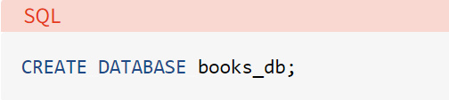

Creating a new database
MySQL Database
To create a new database, you need to execute a SQL statement:
CREATE DATABASE books_db;
The above statement will create a new database with the name books_db.
Notes:
In this slide – Trainer will brief the students about how to create Database
-----------------------------
To initiate the creation of a fresh database, a SQL statement must be executed: "CREATE DATABASE books_db;" This succinct command triggers the establishment of a new database instance bearing the name "books_db." This step is pivotal for organizing and segregating data effectively within the MySQL environment.

Slide 18

Creating a new database
MySQL Database
To execute a SQL query in Python, you’ll need to use a cursor, which abstracts away the access to database records.
MySQL Connector/Python provides you with the MySQLCursor class, which instantiates objects that can execute MySQL queries in Python.
An instance of the MySQLCursor class is also called a cursor.
Cursor objects make use of a MySQLConnection object to interact with your MySQL server. To create a cursor, use the .cursor() method of your connection variable:
The above code gives you an instance of the MySQLCursor class.
Notes:
In this slide – Trainer will brief the students about the MySQL Cursor
-----------------------------
Executing SQL queries in Python involves utilizing a cursor, acting as an abstraction layer that facilitates interaction with database records. In MySQL Connector/Python, this functionality is encapsulated within the MySQLCursor class, which enables the execution of MySQL queries within the Python environment. This class's instances, commonly referred to as cursors, leverage a MySQLConnection object to interface with the MySQL server. To instantiate a cursor, the ".cursor()" method is employed on the connection variable, resulting in an object of the MySQLCursor class. This cursor instance serves as a conduit for executing queries and managing data interactions seamlessly.

Slide 19
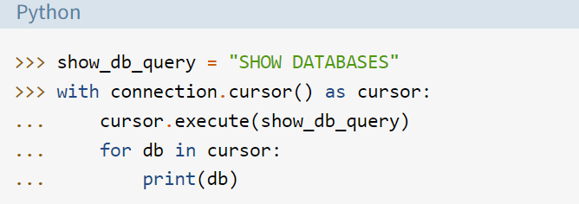
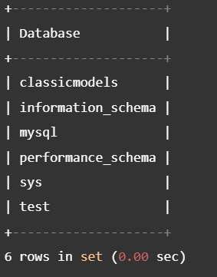
Show Database
MySQL Database
You might receive an error here if a database with the same name already exists in your server.
To confirm this, you can display the name of all databases in your server.
Using the same MySQLConnection object from earlier, execute the SHOW DATABASES statement:
Notes:
In this slide – Trainer will show the students how to view the created MySQL Database
-----------------------------
During the execution of the code segment, it's important to note that an error might arise if a database with an identical name already exists on the server. To ascertain this, a useful approach involves displaying the names of all databases within the server. To achieve this, the MySQLConnection object utilized earlier is employed once more. By executing the "SHOW DATABASES" statement, databases are enumerated and presented. The snippet commences by defining the "Show_db_query" variable with the statement, subsequently employing the cursor context manager and the "execute" method to execute the query. The results are then iterated through using a loop, with each database name printed. This practice offers a valuable insight into the existing databases on the server, helping to circumvent potential conflicts and ensuring a clear overview of the environment's database landscape.

Slide 20
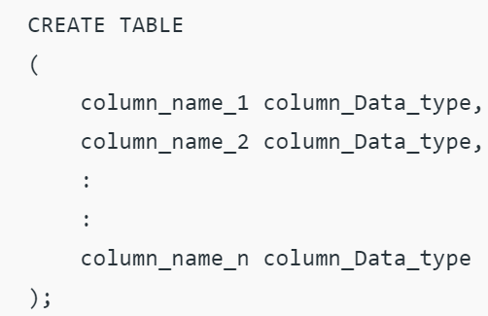
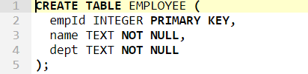
Creating Tables
MySQL Database
For creating tables we will follow the similar approach of writing the SQL commands as strings and then passing it to the execute() method of the cursor object.
SQL command for creating a table is –
Notes:
In this slide – Trainer will show the students how to create Tables in MySQL Database
-----------------------------
Tables serve as pivotal components for structuring and managing data, organizing it in rows and columns akin to spreadsheets' worksheets. With a table creation command, three fundamental elements come into play: the table's name, the names assigned to the fields (columns), and the corresponding definitions for each field. The process of table creation within MySQL is primarily facilitated through two avenues: the MySQL Command Line Client and the MySQL Workbench. Both methods empower users to establish tables within databases, tailoring the data structure to meet specific requirements while adhering to the principles of structured data organization.

Slide 21
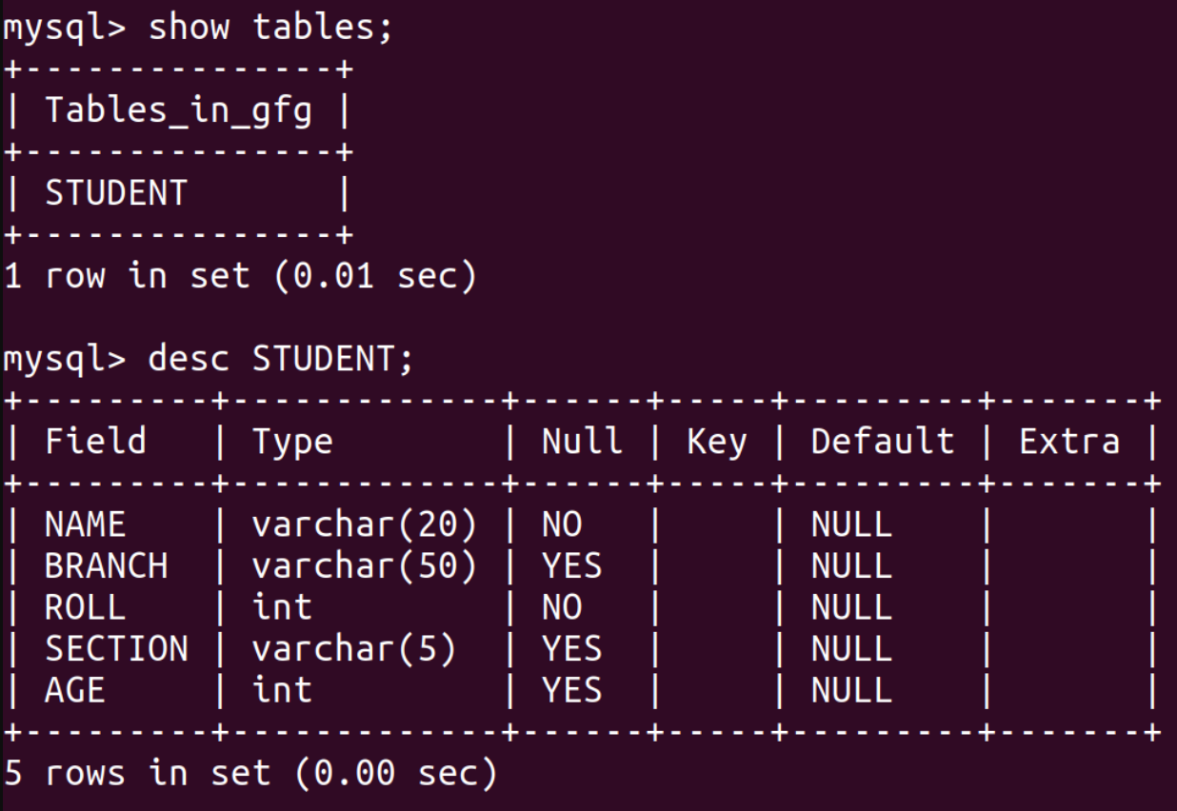
Creating Tables
MySQL Database
import mysql.connector
dataBase = mysql.connector.connect(
host ="localhost",
user ="user",
passwd ="password",
database = "gfg")
cursorObject = dataBase.cursor()
studentRecord = """CREATE TABLE STUDENT (
NAME VARCHAR(20) NOT NULL,
BRANCH VARCHAR(50),
ROLL INT NOT NULL,
SECTION VARCHAR(5),
AGE INT)"""
# table created
cursorObject.execute(studentRecord)
dataBase.close()
Notes:
In this slide – Trainer will show the students about the table creation will example
-----------------------------
The provided Python code snippet demonstrates the process of creating a table within a MySQL database using the MySQL Connector/Python library. This script establishes a connection to a MySQL server with specified credentials and database name, subsequently creating a cursor object for interaction. The script then defines the structure of the "STUDENT" table, encompassing fields such as "NAME," "BRANCH," "ROLL," "SECTION," and "AGE," along with their respective data types and constraints. Upon executing the "CREATE TABLE" statement via the cursor, the table structure is realized within the specified database. Once the operation concludes, the connection is closed using the "dataBase.close()" statement. This example serves to illustrate the essential steps involved in creating structured tables within a MySQL database through Python code.

Slide 22
My SQL – Lab 24
Click below
MySQL
Notes:
In this slide, Trainer will ask the students to click on the link given in the slide – MySQL – Which is a solved question based on a topic. Student may refer the questions, analyze the questions and after the concept is understood. Student may solve another question with the following link.
---------------------------------------------------------------------
Practice Question -: https://github.com/edunetnextgen/Student-Development/blob/main/Full%20Stack%20Development%20with%20Cloud/Module%203/Lab%2024%20Ex2%20Practice%20Question
Practice Question Solution -: https://github.com/edunetnextgen/Student-Development/blob/main/Full%20Stack%20Development%20with%20Cloud/Module%203/Lab%2024%20Ex.2%20Practice%20Question%20Solution

Slide 23
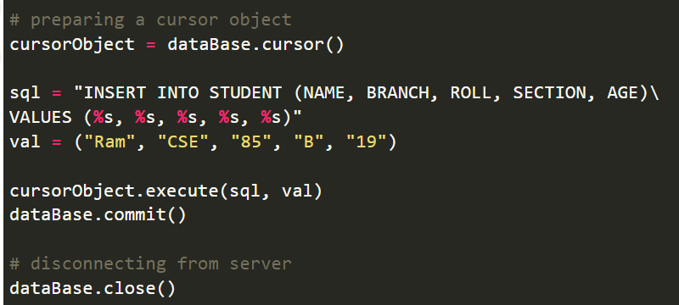
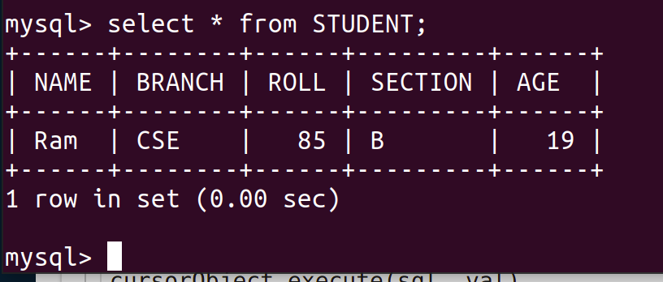
Insert Data into tables
To insert data into the MySQL table Insert into query is used.
Syntax:
INSERT INTO table_name (column_names) VALUES (data)
Notes:
In this slide – Trainer will show the students about how top insert data int table ,ask students to tell some data
-----------------------------
The process of inserting data into a MySQL table is accomplished through the utilization of an "INSERT INTO" query. This query structure entails specifying the target table's name, along with the relevant column names into which data will be inserted. The data to be inserted is encapsulated within the "VALUES" section, aligning with the corresponding column sequence. This syntax enables the seamless incorporation of new data records into the designated MySQL table, facilitating the population of tables with relevant information.

Slide 24
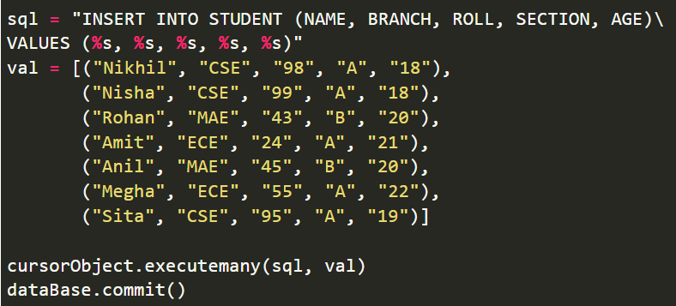
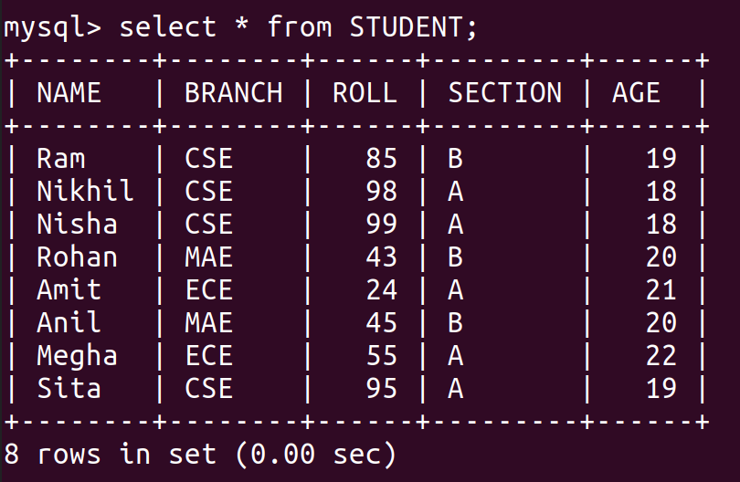
Inserting Multiple Rows
To insert multiple values at once, executemany() method is used. This method iterates through the sequence of parameters, passing the current parameter to the execute method.
Notes:
In this slide – Trainer will show the students about how to insert into multiple row at ones
-----------------------------
The insertion of multiple values into a MySQL table can be efficiently achieved using the "executemany()" method. This method operates by iterating through a sequence of parameters, sequentially passing each parameter to the "execute" method. This iterative process streamlines the insertion of multiple rows of data into the table, enhancing efficiency and avoiding the need for individual insertions. This approach is particularly useful when there's a requirement to populate a table with numerous data entries, facilitating a streamlined and concise workflow.

Slide 25
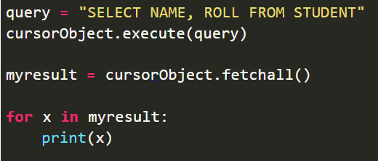

Inserting Multiple Rows
We can use the select query on the MySQL tables
Notes:
In this slide – Trainer will show the students about how to insert into multiple row at ones
-----------------------------
Retrieving data from MySQL tables involves the use of the "SELECT" query, a fundamental SQL operation that enables the extraction of specific information from the database. This query allows users to define criteria and conditions for data selection, facilitating precise data retrieval tailored to their requirements. Through the "SELECT" query, data can be extracted from tables based on specified columns, conditions, and sorting preferences, offering a versatile means of accessing information stored within the database.

Slide 26
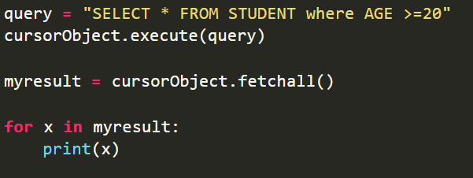
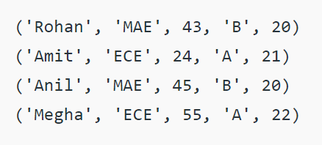
Where Clause
Where clause is used in MySQL database to filter the data as per the condition required.
You can fetch, delete or update a particular set of data in MySQL database by using where clause.
Notes:
In this slide – Trainer will brief the students about Clause
-----------------------------
The "WHERE" clause in MySQL serves as a vital tool for data filtration based on specific conditions. This clause allows users to refine data retrieval, deletion, or updating operations by specifying particular criteria that must be met for the action to take place. With the "WHERE" clause, it becomes possible to target and manipulate a specific subset of data within a MySQL database. This capability enhances the precision and control over database interactions, enabling users to work with specific data subsets that fulfill defined conditions, thus streamlining data management tasks.

Slide 27
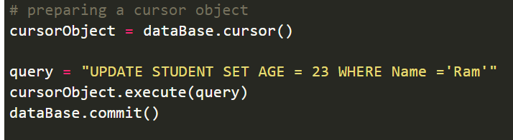
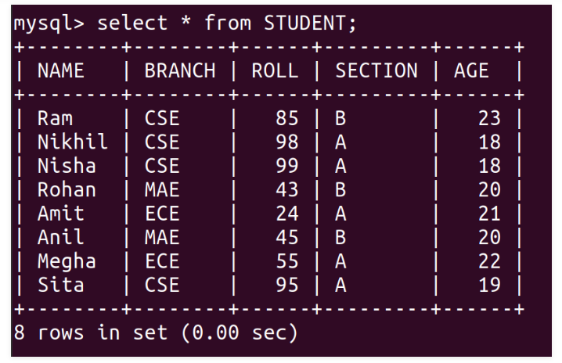
Update Data
The update query is used to change the existing values in a database. By using update a specific value can be corrected or updated. It only affects the data and not the structure of the table. The basic advantage provided by this command is that it keeps the table accurate.
Notes:
In this slide – Trainer will brief and show the students about how to update the data using in comment
-----------------------------
The "UPDATE" query in MySQL constitutes a pivotal tool for modifying existing values within a database. This query empowers users to correct or update specific values, ensuring accuracy and relevance without altering the overall table structure. Unlike structural changes, the "UPDATE" query focuses solely on the data within the table. This command's fundamental benefit lies in its ability to maintain the accuracy of the table's contents, allowing for the swift rectification of errors or updates to ensure the data remains consistent and up-to-date.

Slide 28
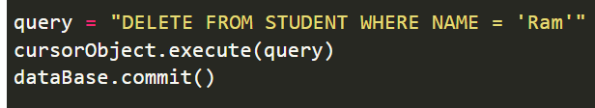
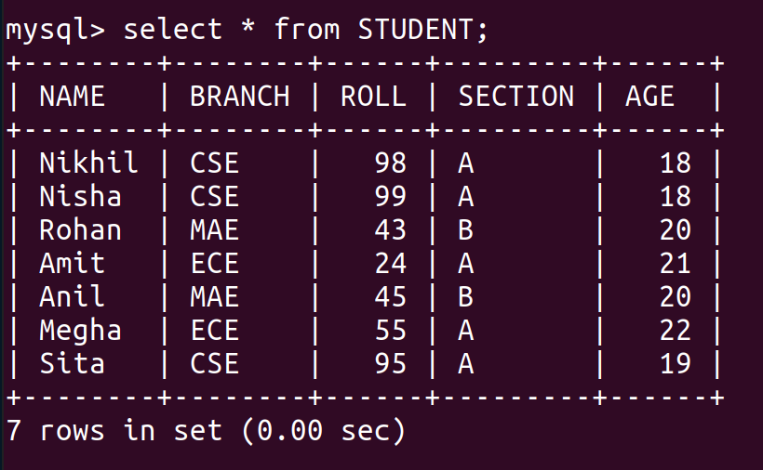
Delete Data from Table
We can use the Delete query to delete data from the table in MySQL.
Notes:
In this slide – Trainer will brief and show the students about how to delete a data using comment
-----------------------------
The "DELETE" query serves as a key mechanism to remove data from MySQL tables. This query enables the selective removal of specific records based on defined criteria, effectively streamlining data management processes. By employing the "DELETE" query, unnecessary or outdated data can be efficiently eliminated from the table, optimizing data organization and resource utilization. This operation is essential for maintaining data integrity and ensuring that the information stored within the table remains relevant and accurate.

Slide 29
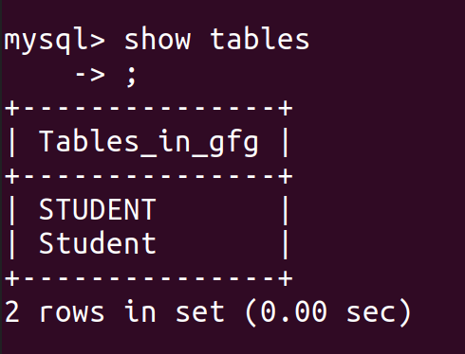
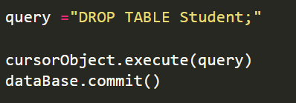
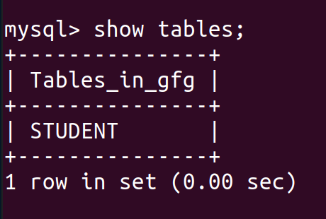
Drop Tables
Drop command affects the structure of the table and not data. It is used to delete an already existing table. For cases where you are not sure if the table to be dropped exists or not DROP TABLE IF EXISTS command is used
Notes:
In this slide – Trainer will brief and show the students about how to drop a table using comment
-----------------------------
The "DROP TABLE" statement is employed within MySQL to eliminate existing tables. This statement carries out a comprehensive removal, eradicating both the entire table structure and its associated data from the database in a permanent manner. Due to the irreversible nature of this operation, careful consideration is vital, as data recovery after deletion is not possible. It's important to emphasize that the "DROP" command impacts the table structure and not the data it holds. It serves as a means to effectively remove a pre-existing table. To navigate scenarios where the table's existence might be uncertain, the "DROP TABLE IF EXISTS" command is a prudent choice, providing a safety net by eliminating the table only if it exists, thus minimizing potential errors.

Slide 30
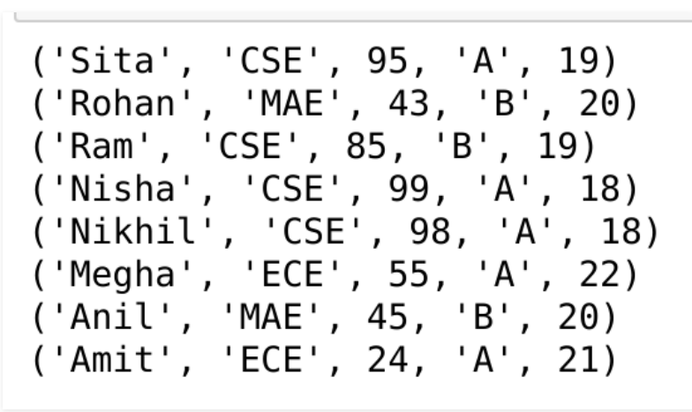
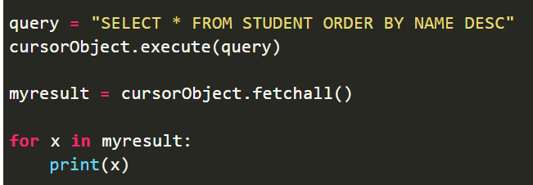
Orberby Clause
OrderBy is used to arrange the result set in either ascending or descending order.
By default, it is always in ascending order unless “DESC” is mentioned, which arranges it in descending order.
“ASC” can also be used to explicitly arrange it in ascending order. But, it is generally not done this way since default already does that.
Notes:
In this slide – Trainer will brief and show the students about orberby clause
-----------------------------
The "ORDER BY" clause plays a pivotal role in organizing the result set of a query within MySQL. This clause facilitates the arrangement of query results, either in ascending or descending order. Ordinarily, the default sorting is ascending, unless specified otherwise using the "DESC" keyword, which triggers descending order sorting. Alternatively, "ASC" can be explicitly used to denote ascending order, although this is typically avoided due to the default's inherent ascending arrangement. The "ORDER BY" clause is a valuable tool for tailoring the presentation of query results according to specific sorting preferences, enhancing the readability and usability of data retrieved from the database.

Slide 31
Python MySQL Connector Lab 25
Click below
Python MySQL Connector
Notes:
In this slide, Trainer will ask the students to click on the link given in the slide – Python MySQL Connector – Which is a solved question based on a topic. Student may refer the questions, analyze the questions and after the concept is understood. Student may solve another question with the following link.
--------------------------------------------------------------------------------------------------------------------------
Practice Question -: https://github.com/edunetnextgen/Student-Development/blob/main/Full%20Stack%20Development%20with%20Cloud/Module%203/Lab%2025%20Ex.2%20Practice%20Question
Practice Question Solution -: https://github.com/edunetnextgen/Student-Development/blob/main/Full%20Stack%20Development%20with%20Cloud/Module%203/Lab%2025%20Ex.2%20Practice%20Question%20Solution

Slide 32

Summary
Well done! You have completed this course and now you have understood about:
You can design and create well-structured databases, ensuring data integrity, minimal redundancy, and efficient data retrieval.
You are capable of using SQL to perform various data manipulation tasks, such as querying, inserting, updating, and deleting data in a relational database.
You can integrate MySQL with various programming languages to build versatile applications that leverage database capabilities.
Notes:
In this slide – Trainer will finalize the unit 3 with the summary and ask the students about the topic and some question
-----------------------------
Designing and creating well-structured databases is essential for effective data management. A well-designed database ensures data integrity, minimizes redundancy, and facilitates efficient data retrieval.

Slide 33
Quiz
1. What is a Database Management System (DBMS)?
A programming language for web development
A software system that manages databases
A graphical user interface for data analysis
A cloud-based data storage service
Answer : B) A software system that manages databases
Notes:
In this slide – Trainer will ask quiz
-----------------------------
A Database Management System (DBMS) is software that enables users to store, manage, and manipulate data in a structured and organized manner. It provides an interface for creating, modifying, and querying databases, which are collections of related data.

Slide 34
Quiz
2. Which of the following is NOT a key feature of a Relational Database Management System (RDBMS)?
Data normalization
Support for structured data
Object-oriented data model
Data integrity enforcement
Answer : C) Object-oriented data model
Notes:
In this slide – Trainer will ask quiz
-----------------------------
"Object-oriented data model" is not a key feature of a Relational Database Management System (RDBMS). RDBMS systems are based on the relational data model, which involves the use of tables (relations) to store and manage structured data.

Slide 35
Quiz
3. Which SQL command is used to retrieve data from a database table?
UPDATE
DELETE
INSERT
SELECT
Answer : D) SELECT
Notes:
In this slide – Trainer will ask quiz
-----------------------------
The SQL command used to retrieve data from a database table is the "SELECT" command. It allows you to query the database and retrieve specific information from one or more tables.

Slide 36
Quiz
4. What is MySQL?
A programming language for web development
A cloud-based database service
A relational database management system
An operating system
Answer : C) A relational database management system
Notes:
In this slide – Trainer will ask quiz
-----------------------------
MySQL is a well-known open-source relational database management system (RDBMS). It is not a programming language or an operating system. MySQL is widely used for managing and organizing structured data within databases, making it a popular choice for various applications, including web development.

Slide 37
Quiz
5. Which Python module is used to interact with MySQL databases through MySQL Python Connector?
mysql_connector
mysql-python
mysql.connector
pymysql
Answer : C) mysql.connector
Notes:
In this slide – Trainer will ask quiz
-----------------------------
The MySQL Python Connector is a module that enables Python applications to interact with MySQL databases. The correct module to use for this purpose is "mysql.connector." While the other options mentioned contain parts of the module name or similar terms, "mysql.connector" is the specific module that facilitates the connection and interaction between Python and MySQL databases.

Slide 38
References
https://www.javatpoint.com/dbms-keys
https://www.guru99.com/dbms-keys.html#7
https://www.javatpoint.com/unique-key-in-sql
https://www.javatpoint.com/dbms-mapping-constraints
https://tutorialwing.com/mapping-constraints-in-dbms-for-relationship-types
https://prepinsta.com/dbms/mapping-constraints/
https://docs.oracle.com/cd/B28359_01/server.111/b28318/part_3.htm
https://dev.mysql.com/doc/refman/8.0/en/features.html
https://www.studytonight.com/
https://www.tutorialspoint.com/
https://www.guru99.com/
https://www.javatpoint.com/
https://www.geeksforgeeks.org/
Notes:
By providing references, we attribute ideas, research findings, and creative expressions to their original creators.

Slide 39
Thank You!
Notes:
Thank you !

